Slide 1
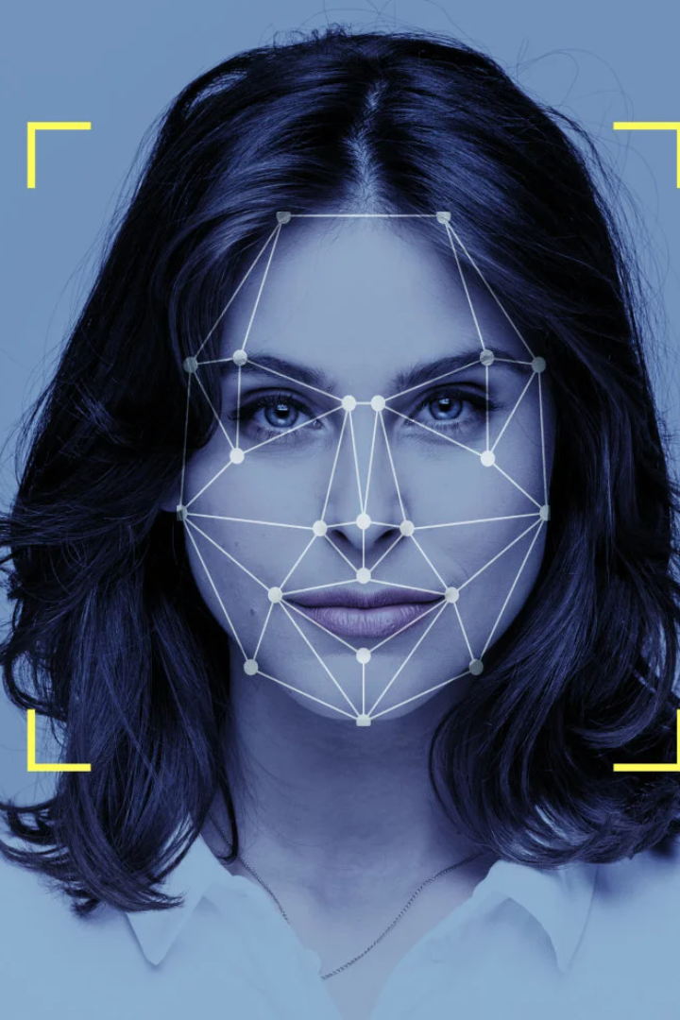
S
Face Recognition Based Attendance System
Submitted By:
Abhishek Patel
(0126CY211002)
Dhananjay Mishra
(0126CY211020)
Submitted To:
Arani Tiwari

Slide 2

Introduction: Importance of Attendance Systems
Attendance systems are vital for accurate recording of employee attendance, ensuring productivity and transparency in organizations.

Slide 3

Gap Analysis
Analyze the existing attendance systems' limitations and identify the gaps that can be filled with face recognition technology.

Slide 4
Literature Review
Explore the latest research and studies on the effectiveness of face recognition technology in attendance management.
Applications of Face Recognition in Attendance Systems:
Implementation in educational institutions, workplaces, and other settings.
Increased accuracy and efficiency compared to traditional methods.
Integration with existing attendance management systems.

Slide 5

Advantages of Face Recognition Technology
1
Accuracy 🎯
2
Efficiency ⏰
3
Security 🔒
Face recognition ensures precise identification and eliminates any chances of proxy attendance.
The automated nature of the system saves time and reduces administrative tasks for HR personnel.
Advanced algorithms and biometric data provide a higher level of security compared to traditional methods.

Slide 6

How Face Recognition Attendance System Works
1
Enrollment
Employees' faces are captured and stored securely in a database to create a reference template.
2
Scanning
During attendance, the facial features are analyzed and matched with the reference template for identification.
3
Recording
The system records the time, date, and attendance status of the employee based on the successful identification.
4
Automaticaly Face detect
Face detection is a computer technology that automatically identifies or verifies a person from a digital image or video frame. It uses machine learning algorithms to detect facial features in a photo or video.

Slide 7
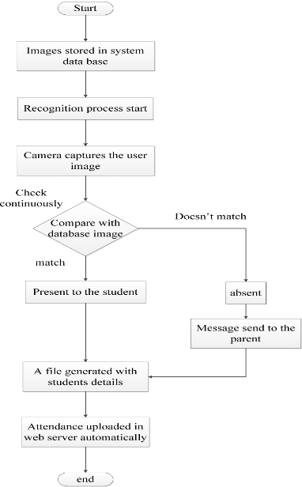
. Flow Chart

Slide 8

Implementation of Face Recognition Attendance System
Hardware
Deploy specialized cameras and hardware devices capable of accurate facial recognition.
Software
Utilize advanced facial recognition algorithms and integrate them with existing attendance management systems.
Training & Onboarding
Provide comprehensive training to employees regarding the new attendance system.

Slide 9



Benefits of Using Face Recognition Attendance System
Increased Productivity
Improved Employee Engagement
Cost Savings
Automating attendance processes frees up time for employees, enhancing productivity in the workplace.
Reduced time and resources spent on manual attendance tracking results in cost savings for the organization.
The use of advanced technology shows employees that the organization prioritizes their well-being.

Slide 10

Challenges and Limitations
Despite its effectiveness, face recognition technology may face challenges such as lighting conditions, hardware limitations, and privacy concerns.

Slide 11

Conclusion: The Future of Face Recognition Attendance Systems
As technology advances, face recognition attendance systems will continue to evolve, revolutionizing workplace management and ensuring efficient operations.

Slide 12
Thank YOU !

